Slide 1

One Variable Optimization
MTH 564 – Mathematical Modeling

Slide 2


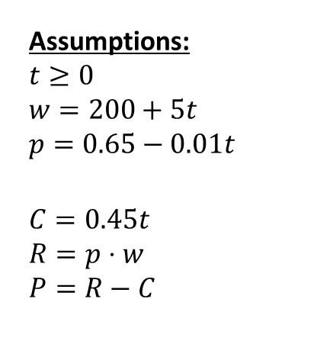
Example: Selling a Pig – Original
A pig weighing 200 lbs. gains 5 lbs. per day and costs $0.45 a day to keep. The market price for pigs is $0.65 per lb., but is falling by $0.01 per day. When should the pig be sold?
Variables:
t – time (in days)
w – weight of pig (lbs.)
p – price for pigs ($/lb.)
C – cost of keeping pig
R – revenue obtained by selling the pig
P – profit
Assumptions:
$$t≥0$$
$$w=200+5t \\ p=0.65−0.01t$$
$$C=0.45t \\ R=p⋅w \\ P=R−C$$
Objective
Maximize $P$
Constants:
200 – starting weight of pig
5 – rate of change of pig’s weight
$0.45 – cost per day
$0.65 – price per pound
$0.01 – amount the price decreases per day

Slide 3
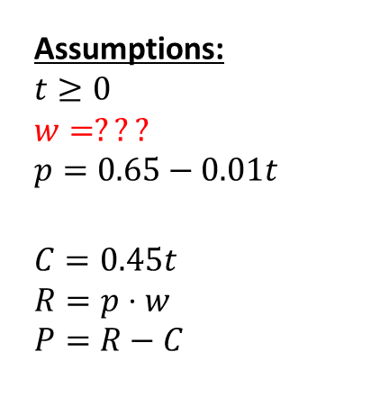
Example: Selling a Pig – Modified
A pig currently weighing 200 lbs. is gaining 5 lbs. per day. The pig is young, so the growth rate is increasing. The pig costs $0.45 a day to keep. The market price for pigs is $0.65 per lb., but is falling by $0.01 per day. When should the pig be sold?
Assumptions:
$$t≥0$$
$$w=??? \\ p=0.65−0.01t$$
$$C=0.45t \\ R=p⋅w \\ P=R−C$$
Objective
Maximize $P$
Variables:
t – time (in days)
w – weight of pig (lbs.)
p – price for pigs ($/lb.)
C – cost of keeping pig
R – revenue obtained by selling the pig
P – profit
Constants:
200 – current weight of pig
5 – current rate of change of pig’s weight
$0.45 – cost per day
$0.65 – price per pound
$0.01 – amount the price decreases per day

Slide 4
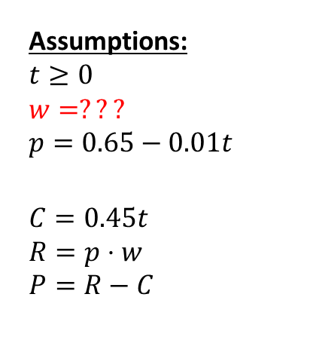
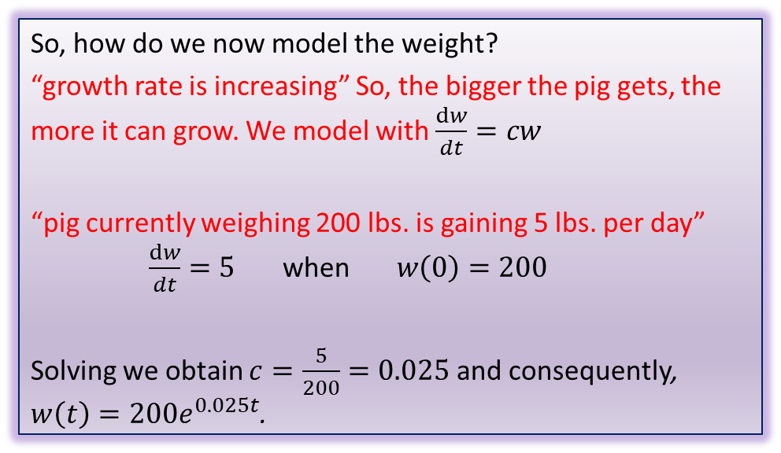
Example: Selling a Pig – Modified
A pig currently weighing 200 lbs. is gaining 5 lbs. per day. The pig is young, so the growth rate is increasing. The pig costs $0.45 a day to keep. The market price for pigs is $0.65 per lb., but is falling by $0.01 per day. When should the pig be sold?
So, how do we now model the weight?
“growth rate is increasing” So, the bigger the pig gets, the more it can grow. We model with $\frac{dw}{dt}=cw$
“pig currently weighing 200 lbs. is gaining 5 lbs. per day” $\frac{dw}{dt}=5$ when $w\left(0\right)=200$
Solving we obtain $c=\frac{5}{200}=0.025$ and consequently, $w\left(t\right)={200e}^{0.025t}$.
Assumptions:
$$t≥0$$
$$w=??? \\ p=0.65−0.01t$$
$$C=0.45t \\ R=p⋅w \\ P=R−C$$

Slide 5
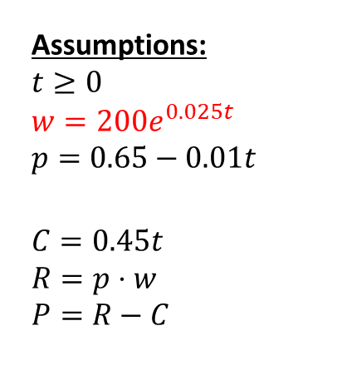
Example: Selling a Pig – Step 2
A pig currently weighing 200 lbs. is gaining 5 lbs. per day. The pig is young, so the growth rate is increasing. The pig costs $0.45 a day to keep. The market price for pigs is $0.65 per lb., but is falling by $0.01 per day. When should the pig be sold?
Variables:
t – time (in days)
w – weight of pig (lbs.)
p – price for pigs ($/lb.)
C – cost of keeping pig
R – revenue obtained by selling the pig
P – profit
Assumptions:
$$t≥0$$
$$w={200e}^{0.025t} \\ p=0.65−0.01t$$
$$C=0.45t \\ R=p⋅w \\ P=R−C$$
Objective
Maximize $P$
Constants:
200 – current weight of pig
5 – current rate of change of pig’s weight
$0.45 – cost per day
$0.65 – price per pound
$0.01 – amount the price decreases per day

Slide 6

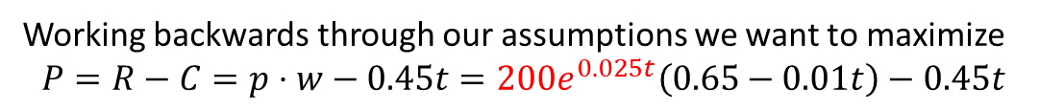
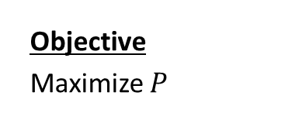
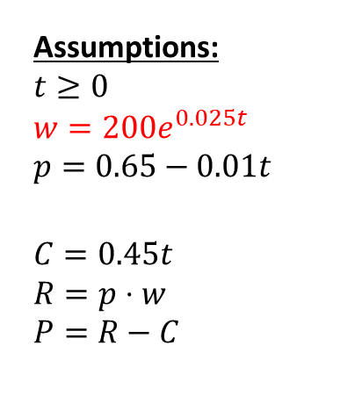
Example: Selling a Pig – Step 3
Variables:
t – time (in days)
w – weight of pig (lbs.)
p – price for pigs ($/lb.)
C – cost of keeping pig
R – revenue obtained by selling the pig
P – profit
Assumptions:
$$t≥0$$
$$w={200e}^{0.025t} \\ p=0.65−0.01t$$
$$C=0.45t \\ R=p⋅w \\ P=R−C$$
Objective
Maximize $P$
Constants:
200 – current weight of pig
5 – current rate of change of pig’s weight
$0.45 – cost per day
$0.65 – price per pound
$0.01 – amount the price decreases per day
Working backwards through our assumptions we want to maximize
$$P=R−C=p⋅w−0.45t={200e}^{0.025t}\left(0.65−0.01t\right)−0.45t$$
Substituting x for t and y=f(x) for P we get the regular old calculus problem Maximize the function
$$f(x)={200e}^{0.025x}\left(0.65−0.01x\right)−0.45x$$
on the interval $[0,∞)$

Slide 7
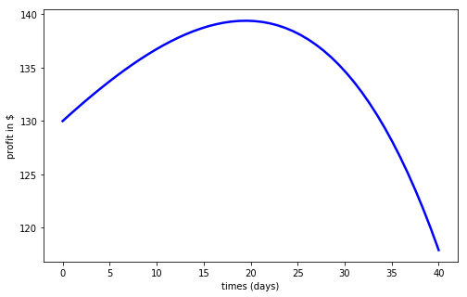

Example: Selling a Pig – Step 4
Maximize the function
$$f(x)={200e}^{0.025x}\left(0.65−0.01x\right)−0.45x$$
on the interval $[0,∞)$
i) This is still a one variable optimization problem:
ii) We now use sympy in python to find the derivative
$$f^{′}\left(x\right)=5.0\left(−0.01x + 0.65\right)e^{0.025x} − 2.0e^{0.025x} − 0.45$$
iii) To find the critical point we need to solve
$$0=5.0\left(−0.01x + 0.65\right)e^{0.025x} − 2.0e^{0.025x} − 0.45$$
iv) We have no hope of solving the above equation. However, we can approximate the solution very accurately using one of several methods.

Slide 8
Approximating Solutions of Equations
We need to solve the following equation
$$0=5.0\left(−0.01x + 0.65\right)e^{0.025x} − 2.0e^{0.025x} − 0.45$$
There are several numerical methods to approximate solutions to equations such as this. Here is a non-comprehensive list:
Bisection Method
Fixed Point Method
Secant Method
Newton’s Method
Brent’s Method
Notes:
Don’t recommend the fixed point method…converges fast but can be fickle

Slide 9
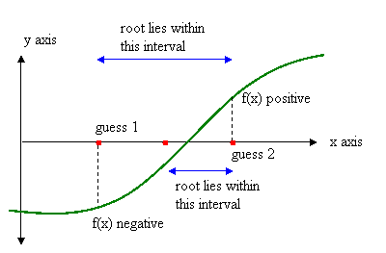
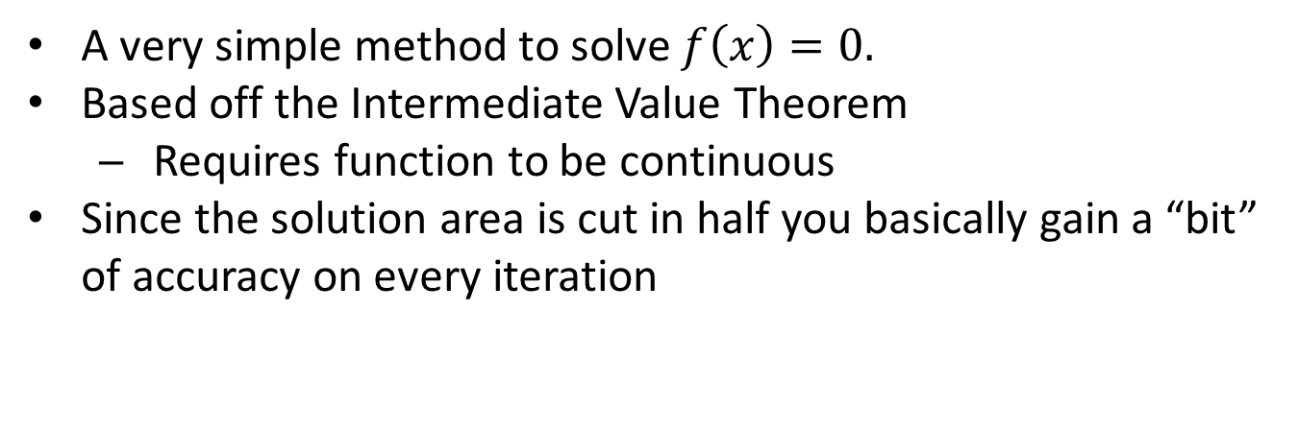
Bisection Method
A very simple method to solve $f\left(x\right)=0.$
Based off the Intermediate Value Theorem
Requires function to be continuous
Since the solution area is cut in half you basically gain a “bit” of accuracy on every iteration

Slide 10
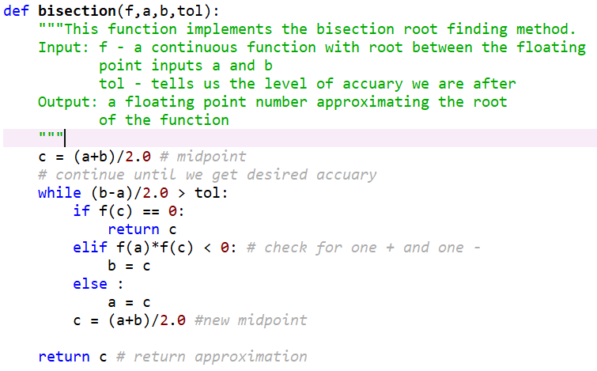
Bisection Method

Slide 11
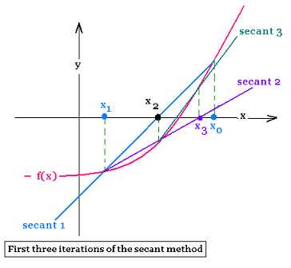
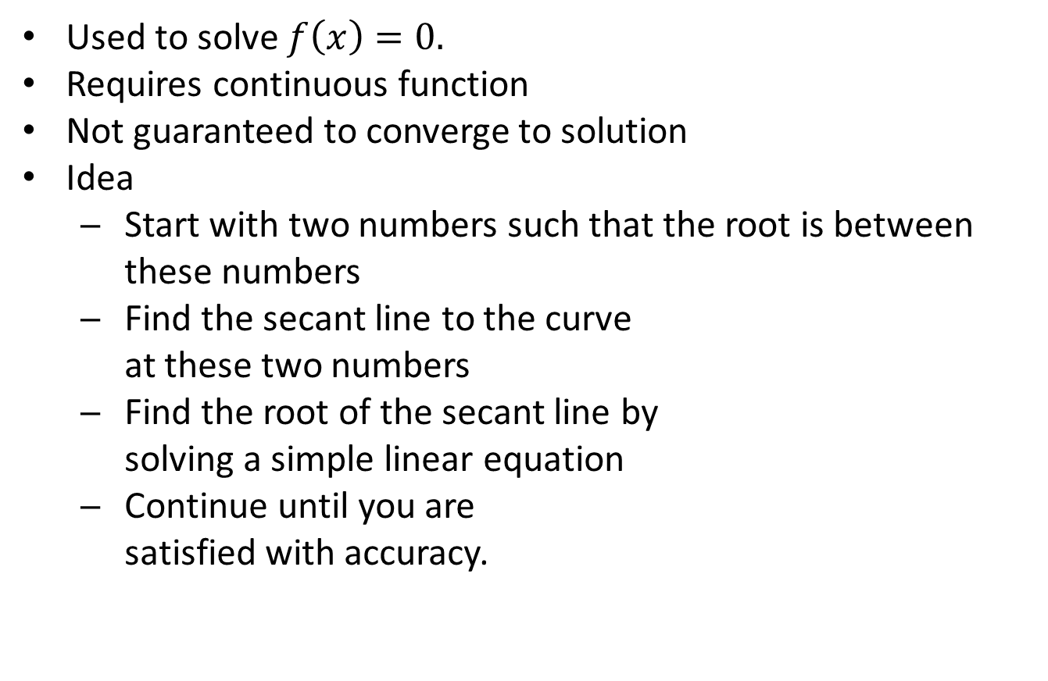
Secant Method
Used to solve $f\left(x\right)=0.$
Requires continuous function
Not guaranteed to converge to solution
Idea
Start with two numbers such that the root is between these numbers
Find the secant line to the curve at these two numbers
Find the root of the secant line by solving a simple linear equation
Continue until you are satisfied with accuracy.

Slide 12
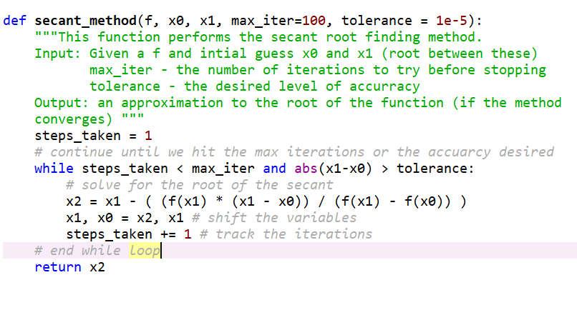
Secant Method

Slide 13
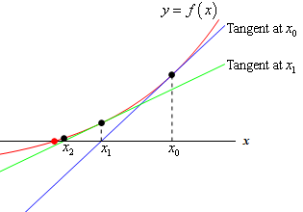
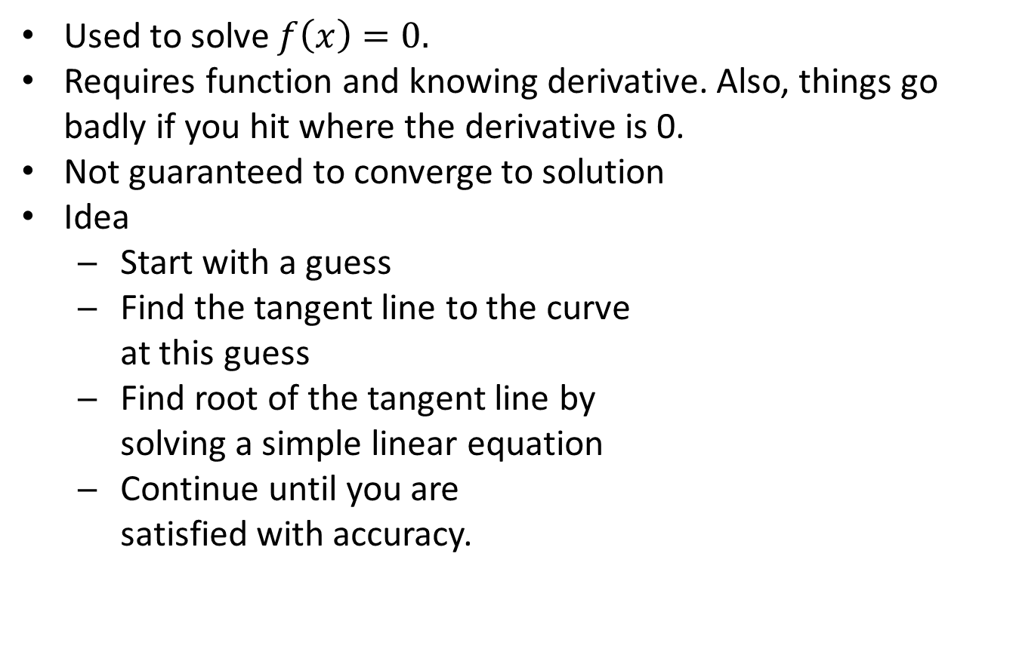
Newton’s Method
Used to solve $f\left(x\right)=0.$
Requires function and knowing derivative. Also, things go badly if you hit where the derivative is 0.
Not guaranteed to converge to solution
Idea
Start with a guess
Find the tangent line to the curve at this guess
Find root of the tangent line by solving a simple linear equation
Continue until you are satisfied with accuracy.

Slide 14
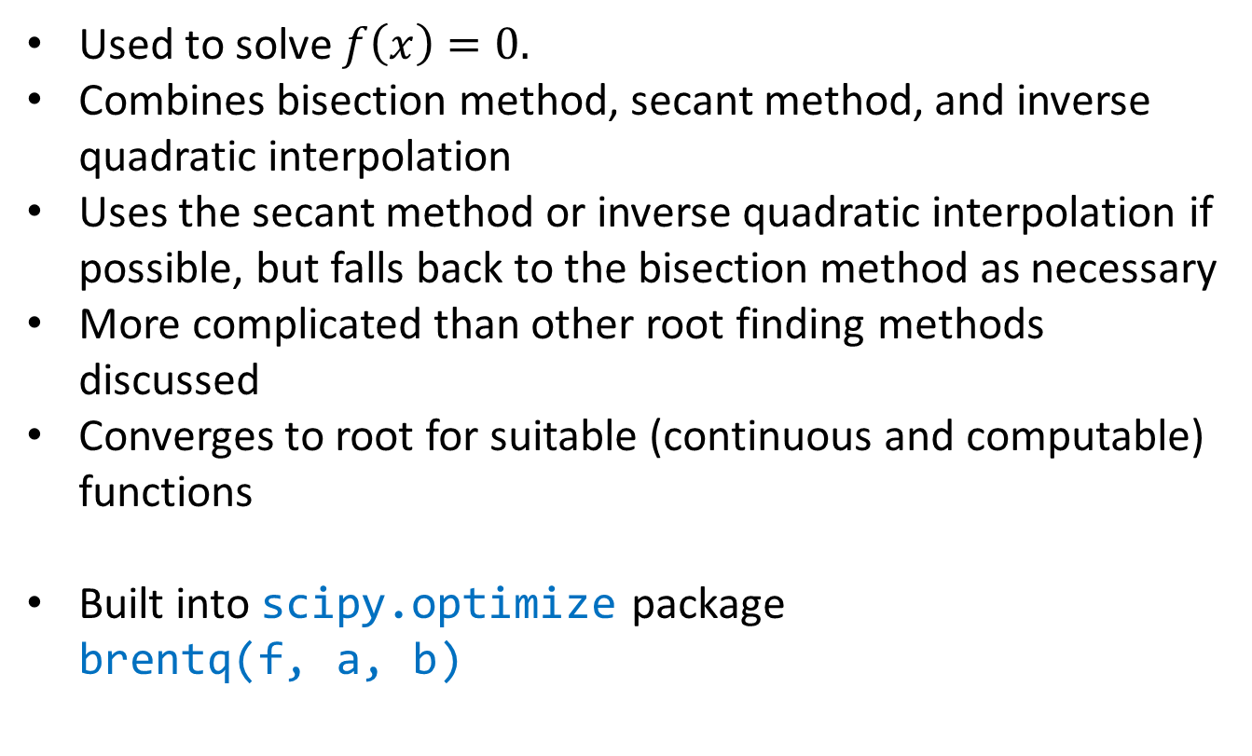
Brent’s (Brent-Dekker) Method
Used to solve $f\left(x\right)=0.$
Combines bisection method, secant method, and inverse quadratic interpolation
Uses the secant method or inverse quadratic interpolation if possible, but falls back to the bisection method as necessary
More complicated than other root finding methods discussed
Converges to root for suitable (continuous and computable) functions
Built into scipy.optimize package brentq(f, a, b)

Slide 15
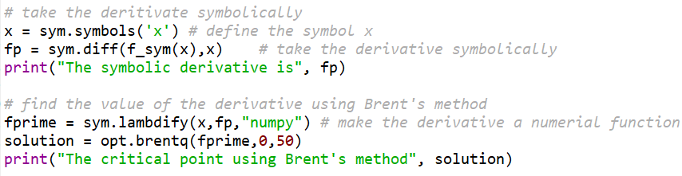
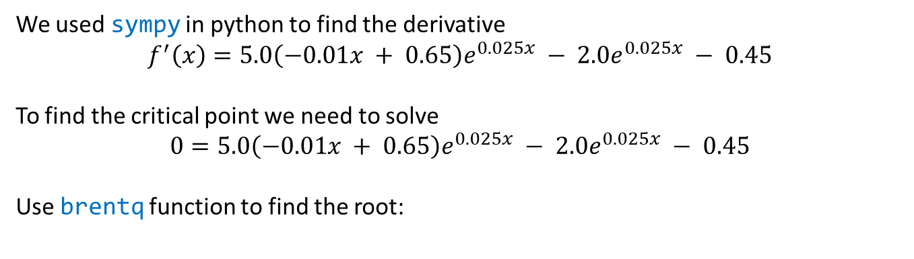

Example: Selling a Pig – Back to Step 4
Maximize the function
$$f(x)={200e}^{0.025x}\left(0.65−0.01x\right)−0.45x$$
on the interval $[0,∞)$
We used sympy in python to find the derivative
$$f^{′}\left(x\right)=5.0\left(−0.01x + 0.65\right)e^{0.025x} − 2.0e^{0.025x} − 0.45$$
To find the critical point we need to solve
$$0=5.0\left(−0.01x + 0.65\right)e^{0.025x} − 2.0e^{0.025x} − 0.45$$
Use brentq function to find the root:

Slide 16
Selling a Pig –Step 4 (Another Python Approach)
Maximize the function
$$f(x)={200e}^{0.025x}\left(0.65−0.01x\right)−0.45x$$
on the interval $[0,∞)$
We actually don’t need to symbolically take the derivative. Python scipy.optimize package has a minimize_scalar function that numerically computes a derivative and performs Brent’s method in the background.
Of course, we do NOT want to minimize, we want to maximize. Fortunately, we can accomplish this by minimizing –f.
Trade-off:
don’t need to find the derivative
we have to a make a “negative” function.
numerical approximation of derivative is another source of possible error.

Slide 17
A Work Of Caution
You may have noticed we solved the problem in a few different ways and confirmed our results with a graph. Why do all this?
Most solvers need a guess or bounds, so looking globally at a graph can help.
Using multiple solvers helps us confirm our results.
Uncritical faith in the results of a solver is dangerous
For many real-world problems the use of solvers can lead to significant errors.
You must always verify your results.

Slide 18
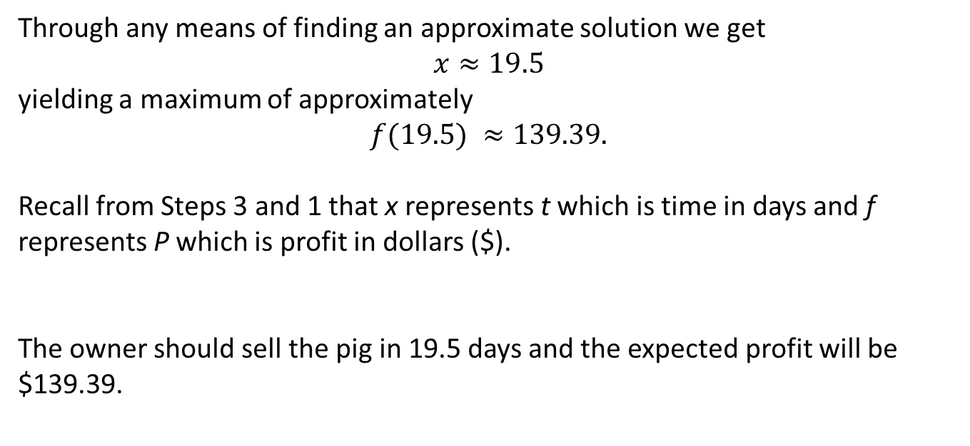

Selling a Pig – Step 5
Maximize the function
$$f(x)={200e}^{0.025x}\left(0.65−0.01x\right)−0.45x$$
on the interval $[0,∞)$
Through any means of finding an approximate solution we get
$$x≈19.5$$
yielding a maximum of approximately
$$f(19.5) ≈139.39.$$
Recall from Steps 3 and 1 that x represents t which is time in days and f represents P which is profit in dollars ($).
The owner should sell the pig in 19.5 days and the expected profit will be $139.39.

Slide 19
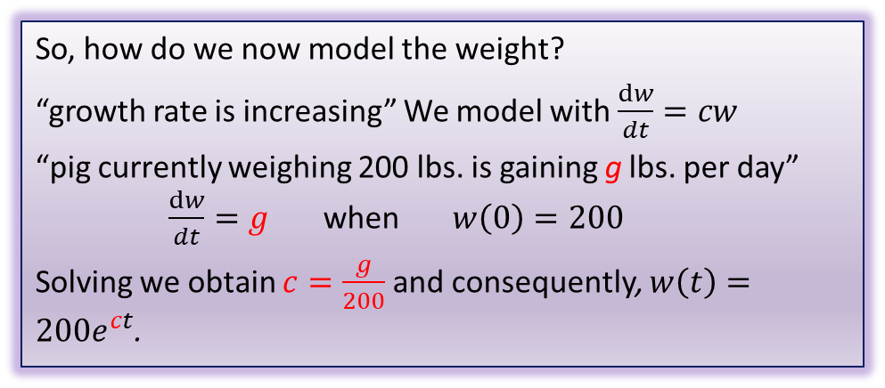
Sensitivity Analysis
Of the parameters, the two most likely to have some error are:
g – rate of change of pig’s weight
r – amount the price decreases per day
We focused on r in Section 1.2, so now we will mostly focus on g. Recall how g is used in the construction of our model:
Parameters:
200 – starting weight of pig
5 – rate of change of pig’s weight
$0.45 – cost per day
$0.65 – price per pound
$0.01 – amount the price decreases per day
So, how do we now model the weight?
“growth rate is increasing” We model with $\frac{dw}{dt}=cw$
“pig currently weighing 200 lbs. is gaining g lbs. per day” $\frac{dw}{dt}=g$ when $w\left(0\right)=200$
Solving we obtain $c=\frac{g}{200}$ and consequently, $w\left(t\right)={200e}^{ct}$.
So, to analyze g, we can perform sensitivity analysis on c.

Slide 20
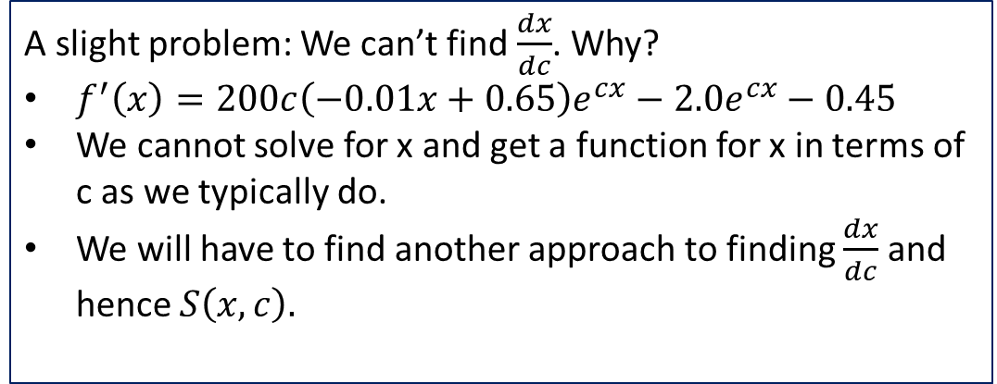

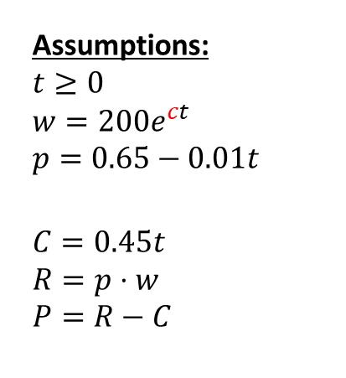
Sensitivity Analysis on c
Assumptions:
$$t≥0$$
$$w={200e}^{ct} \\ p=0.65−0.01t$$
$$C=0.45t \\ R=p⋅w \\ P=R−C$$
Maximize the function
$$f(x)={200e}^{cx}\left(0.65−0.01x\right)−0.45x$$
on the interval $[0,∞)$
A slight problem: We can’t find $\frac{dx}{dc}$. Why?
$f^{′}\left(x\right)=200c\left(−0.01x+0.65\right)e^{cx}−2.0e^{cx}−0.45$
We cannot solve for x and get a function for x in terms of c as we typically do.
We will have to find another approach to finding $\frac{dx}{dc}$ and hence $S\left(x,c\right).$

Slide 21
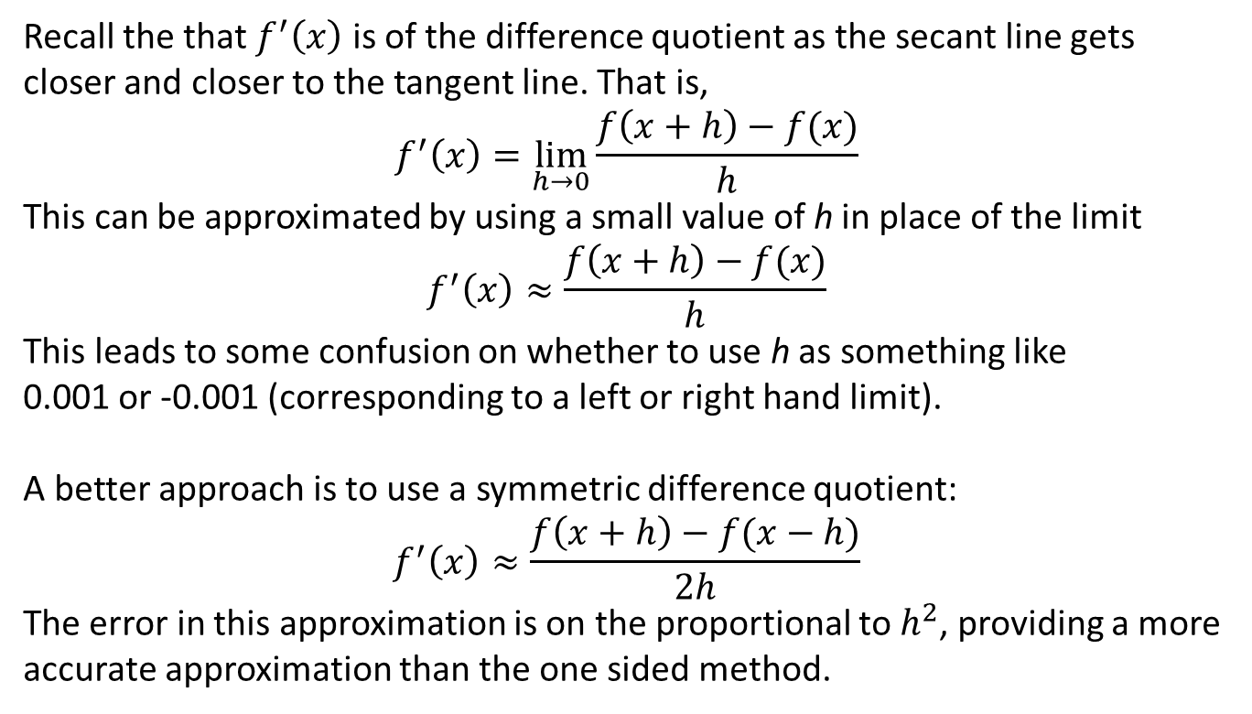
Numerical Approximation of Derivatives
Recall the that $f^{′}\left(x\right)$ is of the difference quotient as the secant line gets closer and closer to the tangent line. That is,
$$f^{′}\left(x\right)=\lim_{h→0}\frac{f\left(x+h\right)−f(x)}{h}$$
This can be approximated by using a small value of h in place of the limit
$$f^{′}\left(x\right)≈\frac{f\left(x+h\right)−f(x)}{h}$$
This leads to some confusion on whether to use h as something like 0.001 or -0.001 (corresponding to a left or right hand limit).
A better approach is to use a symmetric difference quotient:
$$f^{′}\left(x\right)≈\frac{f\left(x+h\right)−f(x−h)}{2h}$$
The error in this approximation is on the proportional to $h^{2}$, providing a more accurate approximation than the one sided method.

Slide 22
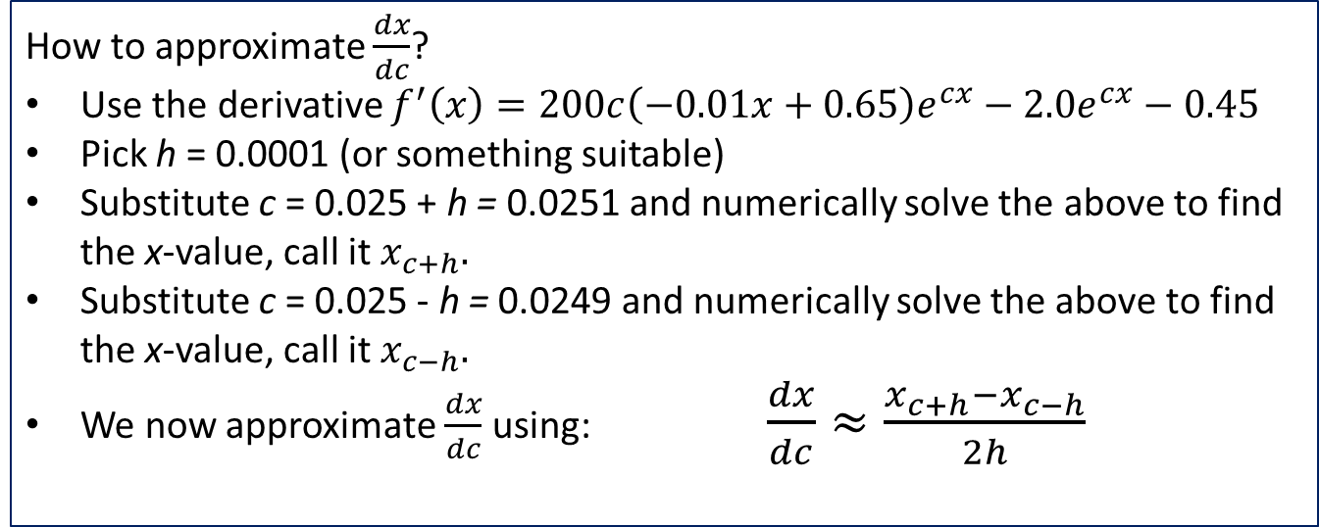

Sensitivity Analysis: Finding dx/dc
Maximize the function
$$f(x)={200e}^{cx}\left(0.65−0.01x\right)−0.45x$$
on the interval $[0,∞)$
How to approximate $\frac{dx}{dc}$?
Use the derivative $f^{′}\left(x\right)=200c\left(−0.01x+0.65\right)e^{cx}−2.0e^{cx}−0.45$
Pick h = 0.0001 (or something suitable)
Substitute c = 0.025 + h = 0.0251 and numerically solve the above to find the x-value, call it $x_{c+h}.$
Substitute c = 0.025 - h = 0.0249 and numerically solve the above to find the x-value, call it $x_{c−h}.$
We now approximate $\frac{dx}{dc}$ using:$\frac{dx}{dc}≈\frac{{x_{c+h}−x}_{c−h}}{2h}$

Slide 23
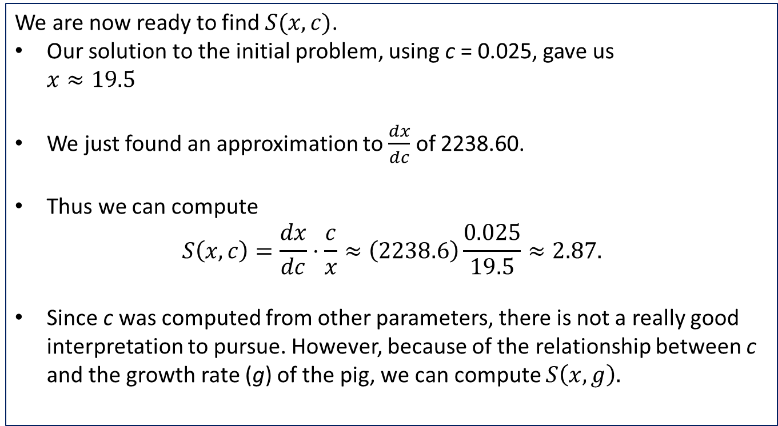
Sensitivity Analysis on c
We are now ready to find$S(x,c)$.
Our solution to the initial problem, using c = 0.025, gave us $x≈19.5$
We just found an approximation to $\frac{dx}{dc}$ of 2238.60.
Thus we can compute
$$S\left(x,c\right)=\frac{dx}{dc}⋅\frac{c}{x}≈\left(2238.6\right)\frac{0.025}{19.5}≈2.87.$$
Since c was computed from other parameters, there is not a really good interpretation to pursue. However, because of the relationship between c and the growth rate (g) of the pig, we can compute $S\left(x,g\right).$

Slide 24
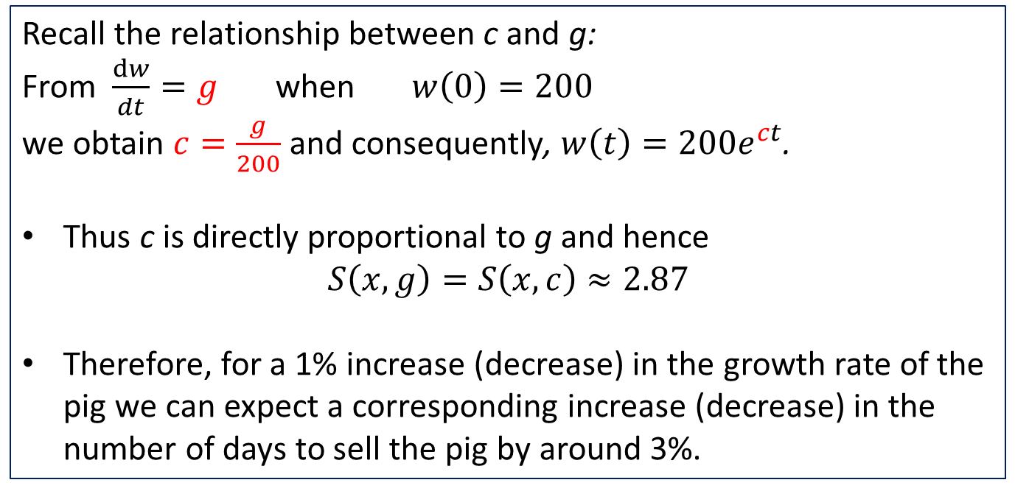
Sensitivity Analysis on g
Recall the relationship between c and g:
From $\frac{dw}{dt}=g$ when $w\left(0\right)=200$
we obtain $c=\frac{g}{200}$ and consequently, $w\left(t\right)={200e}^{ct}$.
Thus c is directly proportional to g and hence $S\left(x,g\right)=S\left(x,c\right)≈2.87$
Therefore, for a 1% increase (decrease) in the growth rate of the pig we can expect a corresponding increase (decrease) in the number of days to sell the pig by around 3%.

Slide 25
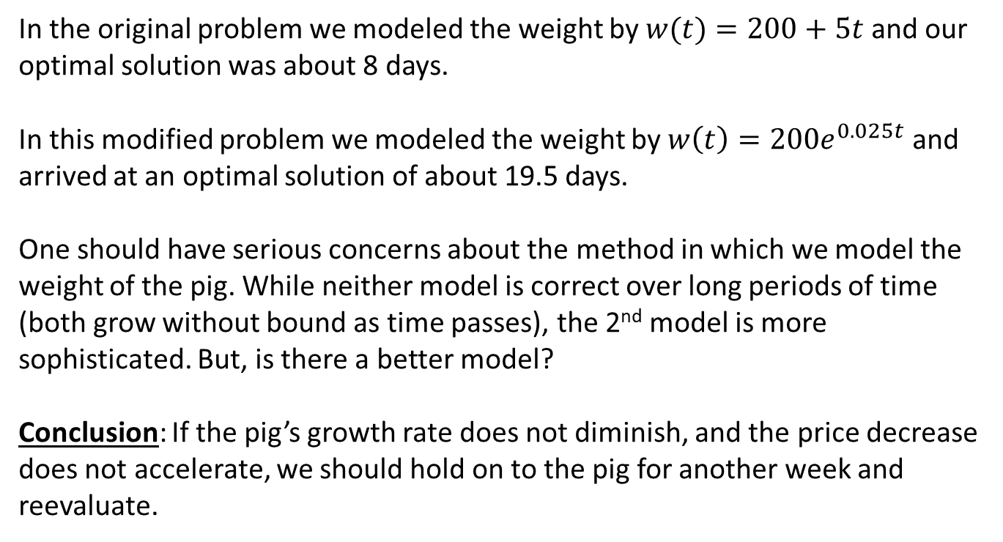
Robustness
In the original problem we modeled the weight by $w(t)=200+5t$ and our optimal solution was about 8 days.
In this modified problem we modeled the weight by $w\left(t\right)={200e}^{0.025t}$ and arrived at an optimal solution of about 19.5 days.
One should have serious concerns about the method in which we model the weight of the pig. While neither model is correct over long periods of time (both grow without bound as time passes), the 2nd model is more sophisticated. But, is there a better model?
Conclusion: If the pig’s growth rate does not diminish, and the price decrease does not accelerate, we should hold on to the pig for another week and reevaluate.

